Slide 1


CREDIT CARD DEFAULT PREDICTION
CAPSTONE PROJECT (DATA-606) SAI VARA PRASAD JOGIPARTHI

Slide 2

PROBLEM STATEMENT
Credit card defaults cause major financial losses
Banks need early identification of risky customers
Manual assessment is slow and inconsistent
Goal: Build a model to predict default risk

Slide 3
PROJECT OBJECTIVE
Predict whether a customer will default or not
Use historical financial and behavioral data
Build a reliable machine learning model
Deploy a simple web app for predictions

Slide 4

DATASET OVERVIEW
Dataset: UCI Credit Card Dataset
Number of records: ~30,000
Includes demographic + financial data
Target variable: Default (Yes/No)

Slide 5
FEATURES USED
Credit limit (LIMIT_BAL)
Age, Gender, Education, Marriage
Payment history (last 6 months)
Bill amounts
Previous payment amounts
Features represent customer financial behavior

Slide 6
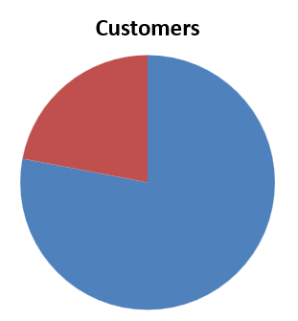
TARGET DISTRIBUTION
Majority of customers do NOT default
Dataset is imbalanced
This affects model performance
Around ~22% defaults vs ~78% non-defaults

Slide 7
DATA PRE-PROCESSING
No missing values were found
Deleted duplicated rows
Encoded categorical variables
Feature selection applied
Data split into training and testing sets

Slide 8
EXPLORATORY DATA ANALYSIS (EDA)
Payment history strongly affects default
Higher delay → higher default risk
Lower payments → higher risk
Younger customers show slightly higher risk

Slide 9
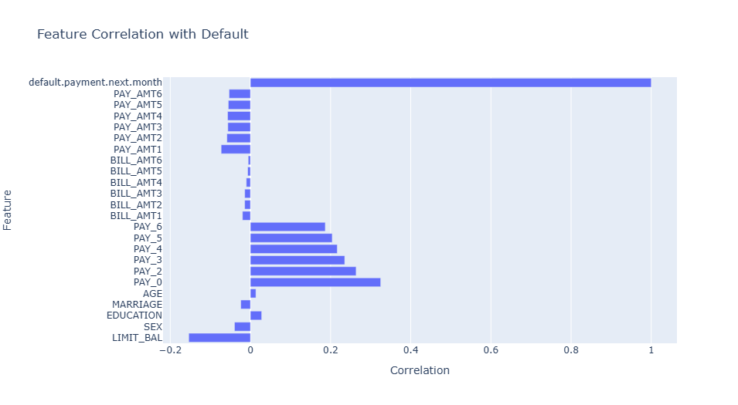
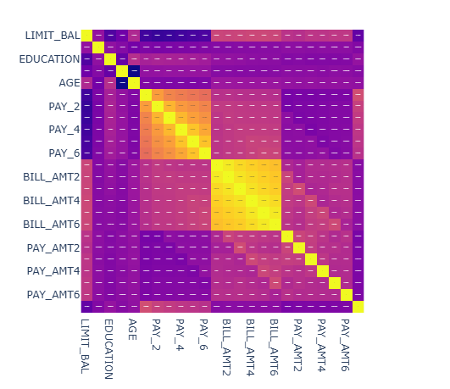
FEATURES CORRELATION

Slide 10
MODEL BUILDING
Used machine learning algorithms
Tried multiple models
Trained Logistic regression, Decision trees, K nearest neighbor, Random forest and XGBoost
Selected best-performing model
Final model: XGBoost Classifier

Slide 11
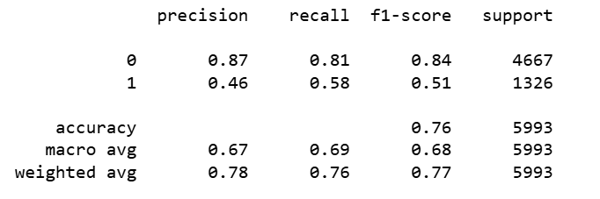
MODEL PERFORMANCE
Accuracy: ~75%
Precision and Recall evaluated
Better at predicting non-defaults
Some difficulty with minority class
Imbalance affected performance

Slide 12
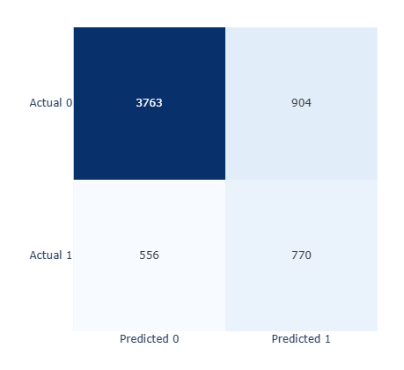
CONFUSION MATRIX
Shows correct and incorrect predictions
High true negatives
Lower true positives
Model struggles slightly with detecting defaults

Slide 13
WEB APPLICATION
Built using Streamlit
User inputs customer details
Model predicts default risk instantly
Displays probability score
Simple and interactive UI

Slide 14
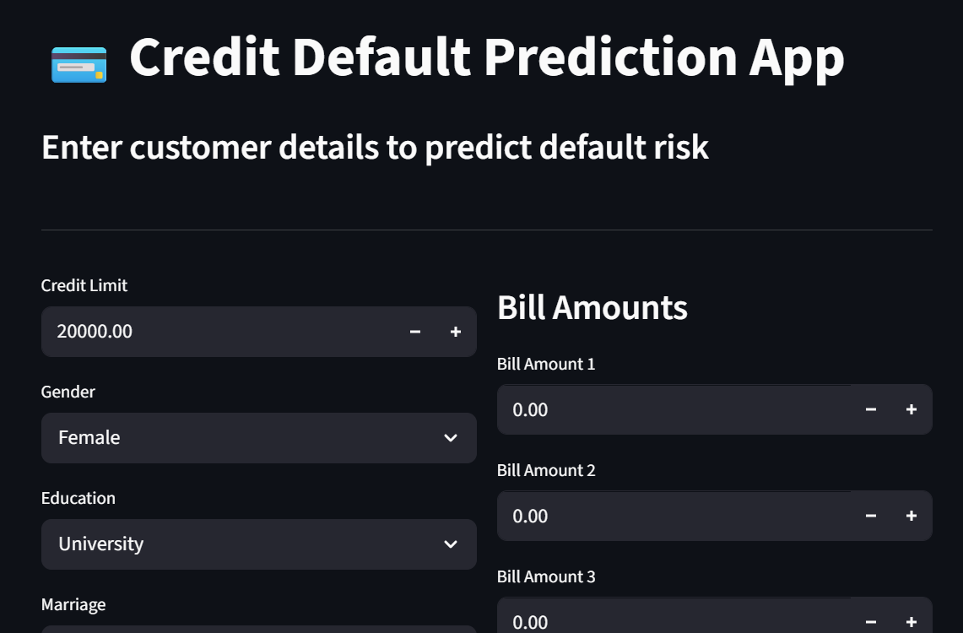
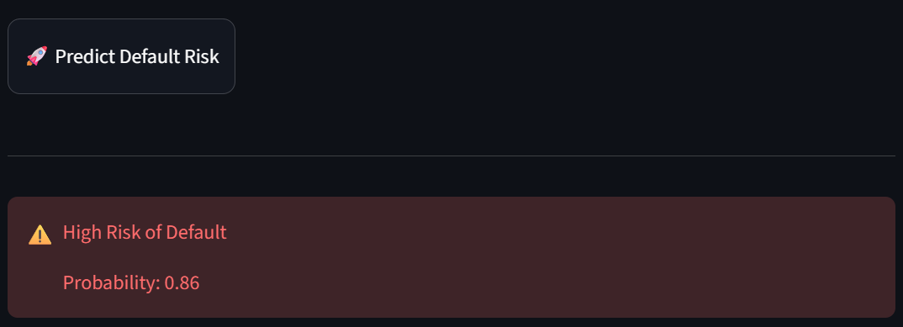
APPLICATION OUTPUT
Shows Low Risk / High Risk
Displays probability of default
Helps in quick decision making

Slide 15
CONCLUSION & FUTURE SCOPE
Successfully built prediction model
Identified key risk factors
Created a working web application
Future Improvements:
Handle imbalance better (SMOTE / tuning)
Improve recall for default cases
Deploy on cloud for real-world use

